Slide 1
Diodes
Introduction, Approximations, Series and parallel configuration, Problems

Slide 2
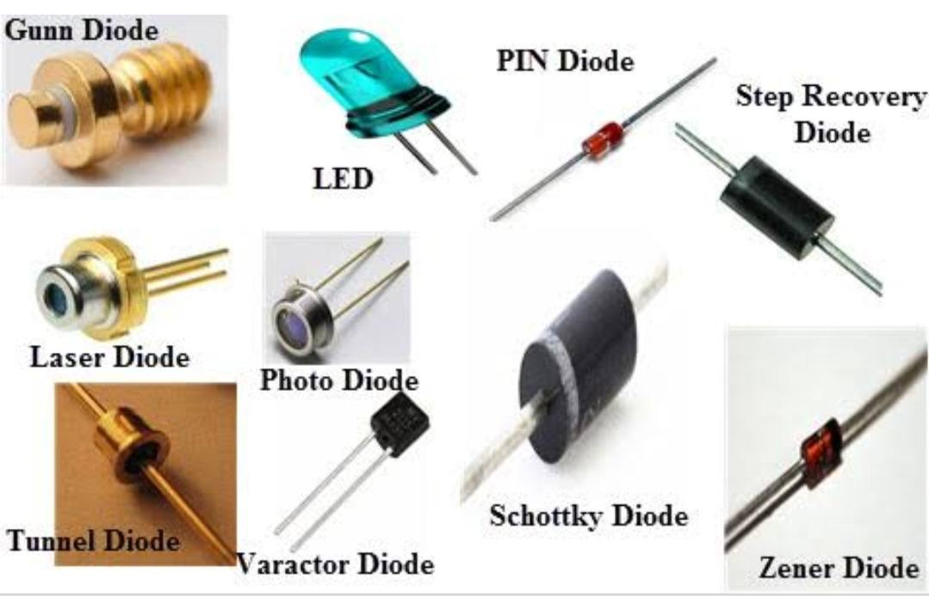

Slide 3
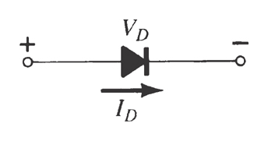
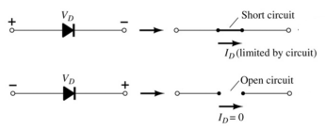
Diodes
The diode is a 2-terminal device.
A diode ideally conducts in only one direction.

Slide 4
Application of diodes
Some Common Applications of Diodes
Rectifiers.
Clipper Circuits.
Clamping Circuits.
Reverse Current Protection Circuits.
In Logic Gates.
Voltage Multipliers.

Slide 5
Area of Application
A single diode cannot meet higher voltage requirements, unless it is connected in series. So the major areas of application are:
HVDC (High voltage direct current) transmission lines.
Commercial areas where regulated voltage supply is needed.

Slide 6
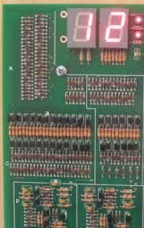
Are there diodes in computers
Diode logic (DL), or diode-resistor logic (DRL), is the construction of Boolean logic gates from diodes. Diode logic was used extensively in the construction of early computers, where semiconductor diodes could replace bulky and costly active vacuum tube elements.

Slide 7
Importance in electronic Application
The most common use of diodes is to remove the negative component of an AC signal. Because the negative portion of an AC waveform is usually identical to the positive half, very little information is effectively lost in this process of stripping it away, leading to more efficient signal processing

Slide 8
What is an Ideal Diode?
An ideal diode is a diode that acts like a perfect conductor when voltage is applied forward biased and like a perfect insulator when voltage is applied reverse biased.
So when positive voltage is applied across the anode to the cathode, the diode conducts forward current instantly. When voltage is applied in reverse, the diode conducts no current at all.

Slide 9
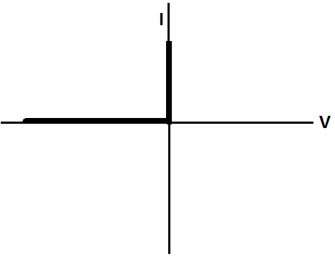
Ideal Diode Characteristics curve when the diode receives forward voltage, it instantly conducts an infinite amount of current which it can supply to a circuit. When reverse voltage is fed to the diode, it conducts no current at all, no matter how great this reverse voltage is.

Slide 10
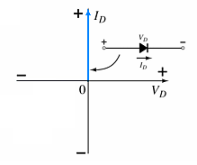
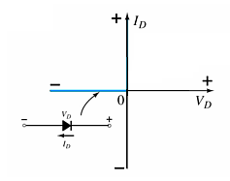
Diode Characteristics
Conduction Region
Non-Conduction Region
The voltage across the diode is 0 V
The current is infinite
The forward resistance is defined as
R_{F} = V_{F} / I_{F}
The diode acts like a short
All of the voltage is across the diode
The current is 0 A
The reverse resistance is defined as
R_{R} = V_{R} / I_{R}
The diode acts like open

Slide 11
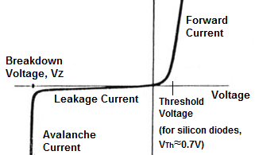
Conventional Diode Characteristics Curve

Slide 12
Semiconductor Materials
Materials commonly used in the development of semiconductor devices:
Silicon (Si)
Germanium (Ge)
Gallium Arsenide (GaAs)

Slide 13
Doping
The electrical characteristics of silicon and germanium are improved by adding materials in a process called doping.
There are just two types of doped semiconductor materials:
n-type p-type
n-type materials contain an excess of conduction band electrons.
p-type materials contain an excess of valence band holes.

Slide 14
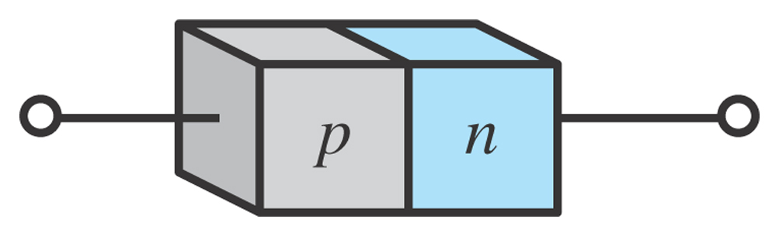
p-n Junctions
One end of a silicon or germanium crystal can be doped as a p-type material and the other end as an n-type material.
The result is a p-n junction

Slide 15
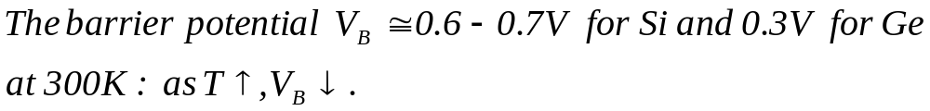
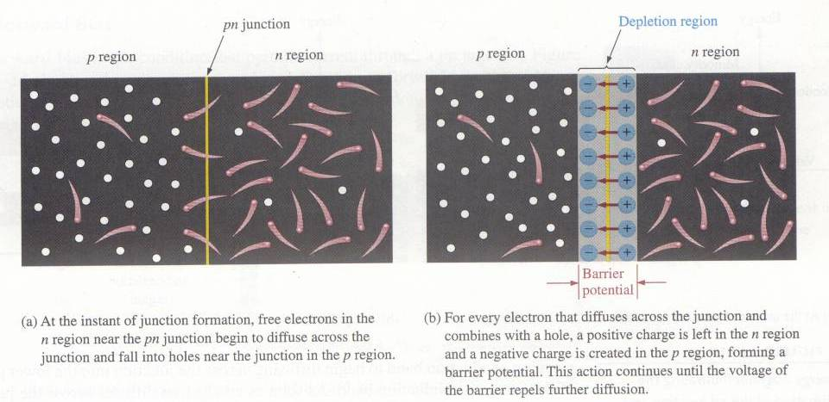
Pn junction
* The interface in-between p-type and n-type material is called a
pn-junction.

Slide 16
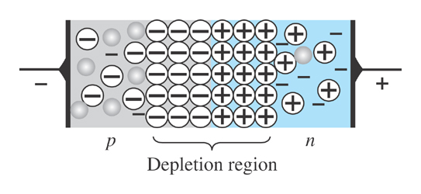
p-n Junctions
At the p-n junction, the excess conduction-band electrons on the n-type side are attracted to the valence-band holes on the p-type side.
The electrons in the n-type material migrate across the junction to the p-type material (electron flow).
Electron migration results in a negative charge on the p-type side of the junction and a positive charge on the n-type side of the junction.
The result is the formation of a depletion region around the junction.

Slide 17
Diode Operating Conditions
A diode has three operating conditions:
No bias
Reverse bias
Forward bias

Slide 18
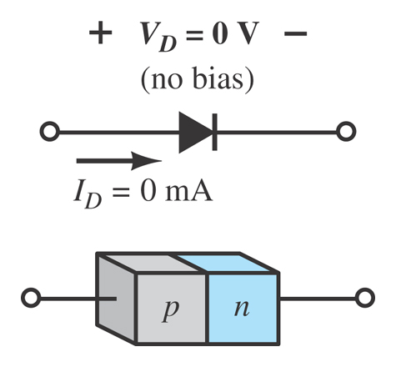
Diode Operating Conditions
No Bias
No external voltage is applied: V_{D} = 0 V
There is no diode current: I_{D} = 0 A
Only a modest depletion region exists

Slide 19
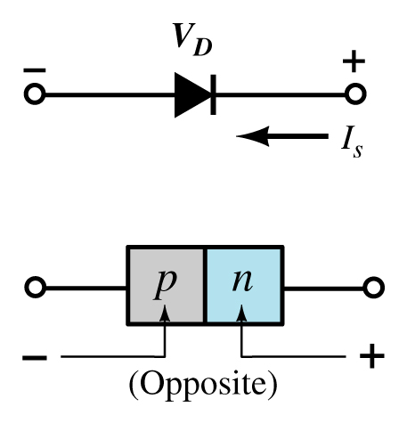
Diode Operating Conditions
Reverse Bias
External voltage is applied across the p-n junction in the opposite polarity of the p- and n-type materials.

Slide 20
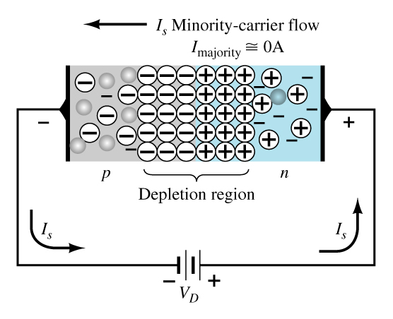
Diode Operating Conditions
Reverse Bias
The reverse voltage causes the depletion region to widen.
The electrons in the n-type material are attracted toward the positive terminal of the voltage source.
The holes in the p-type material are attracted toward the negative terminal of the voltage source.

Slide 21
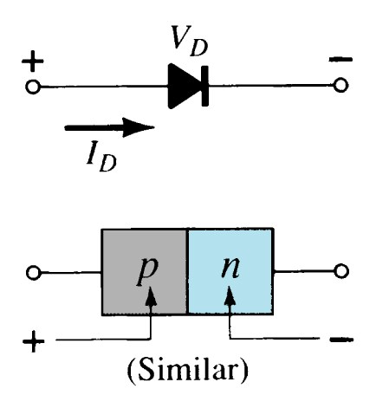
Diode Operating Conditions
Forward Bias
External voltage is applied across the p-n junction in the same polarity as the p- and n-type materials.

Slide 22
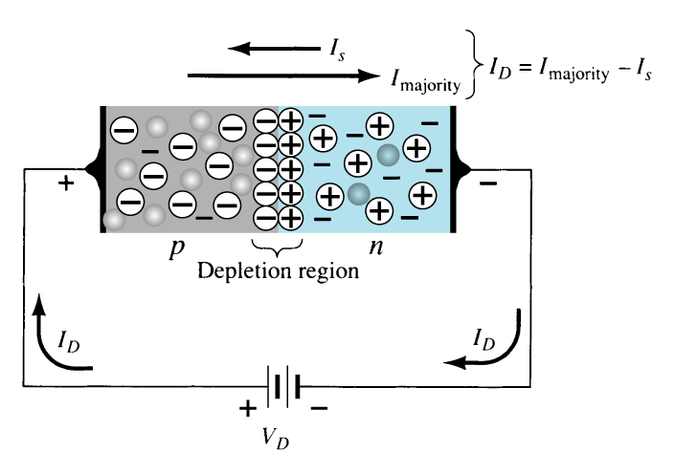
Diode Operating Conditions
Forward Bias
The forward voltage causes the depletion region to narrow.
The electrons and holes are pushed toward the p-n junction.
The electrons and holes have sufficient energy to cross the p-n junction.

Slide 23
Majority and Minority Carriers
Two currents through a diode:
Majority Carriers
The majority carriers in n-type materials are electrons.
The majority carriers in p-type materials are holes.
Minority Carriers
The minority carriers in n-type materials are holes.
The minority carriers in p-type materials are electrons.

Slide 24
Forward Bias Voltage
The point at which the diode changes from no-bias condition to forward-bias condition occurs when the electrons and holes are given sufficient energy to cross the p-n junction. This energy comes from the external voltage applied across the diode.
The forward bias voltage required for a:
gallium arsenide diode ≅ 1.2 V silicon diode ≅ 0.7 V, germanium diode ≅ 0.3 V

Slide 25
Other Types of Diodes
There are several types of diodes besides the standard p-n junction diode. Three of the more common are:
Zener diodes
Light-emitting diodes
Diode arrays

Slide 26
Chapter 2:
Diode Applications

Slide 27
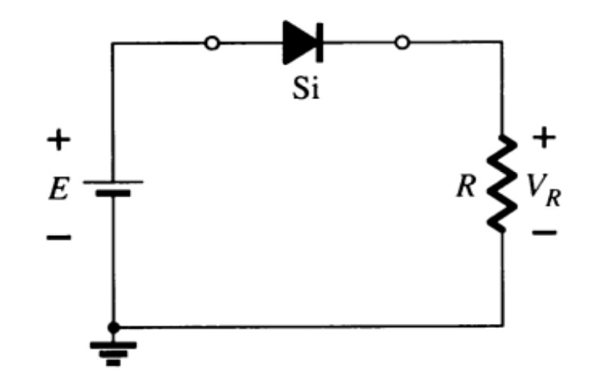
Series Diode Configurations
Forward Bias
Constants
Silicon Diode: V_{D} = 0.7 V
Germanium Diode: V_{D} = 0.3 V
Analysis (for silicon)
V_{D} = 0.7 V (or V_{D} = E if E < 0.7 V)
V_{R} = E – V_{D}
I_{D} = I_{R} = I_{T} = V_{R} / R

Slide 28
Diode Characteristics in Series Configuration
When connected in series, we observe the following properties to hold true among the diodes:
Resultant diode’s forward voltage increases.
Reverse blocking capabilities of diodes are increased in series connection.

Slide 29
Diode Approximtions
What is Diode Approximation?
Diode approximation is a mathematical method used to approximate the nonlinear behavior of real diodes to enable calculations and circuit analysis. There are three different approximations used to analyze the diode circuits.

Slide 30
First diode approximation
In the first approximation method, the diode is considered as a forward-biased diode and as a closed switch with zero voltage drop. It is not apt to use in real-life circumstances but used only for general approximations where preciseness is not required.

Slide 31
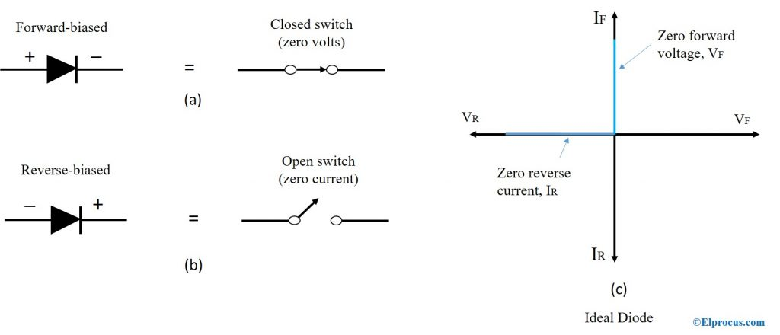
first-approximation

Slide 32
Second diode Approximtion
In the second approximation, the diode is considered as a forward-biased diode in series with a battery to turn on the device. For a silicon diode to turn on, it needs 0.7V. A voltage of 0.7V or greater is fed to turn on the forward-biased diode. The diode turns off if the voltage is less than 0.7V.

Slide 33
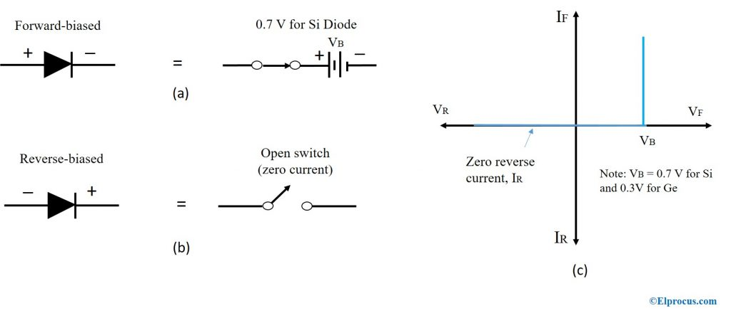
Second Approximtion

Slide 34
Third Approximation
The third approximation of a diode includes voltage across the diode and voltage across bulk resistance, R_{B}. The bulk resistance is low, such as less than 1 ohm and always less than 10 ohms. The bulk resistance, R_{B} corresponds to the resistance of p and n materials. This resistance changes based on the amount of forwarding voltage and the current flowing through the diode at any given time.
The voltage drop across the diode is calculated using the formula

Slide 35
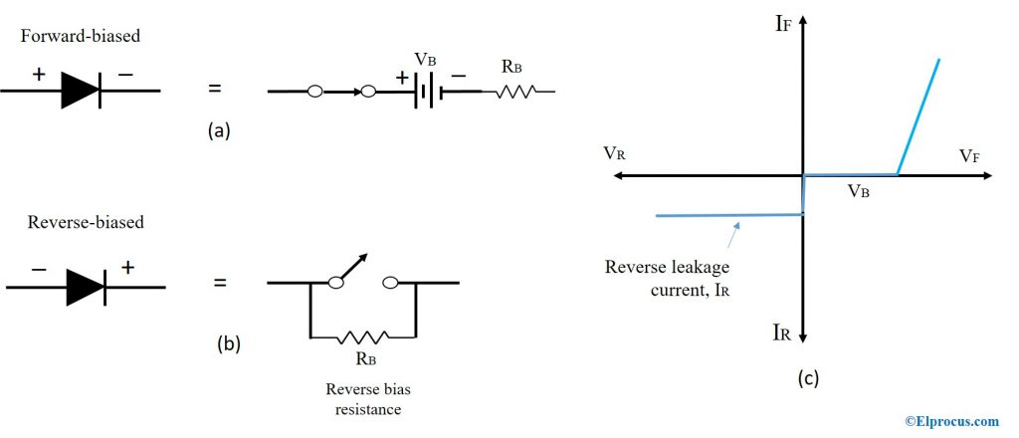
Third Approximtion
V_{d} = 0.7V + I_{d} *R_{B}
And if R_{B} < 1/100 R_{Th} or R_{B} < 0.001 R_{Th}, we neglect that

Slide 36
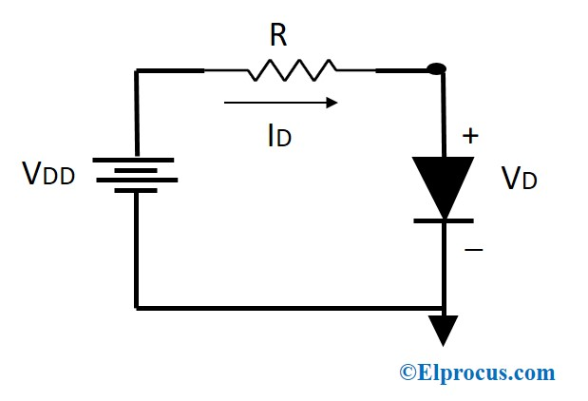
Problem
Use the second approximation of diode and find the current flowing through the diode.

Slide 37
Solution
I_{D} =(V_{s} – V_{D})/R = (4-0.7)/8 = 0.41A

Slide 38
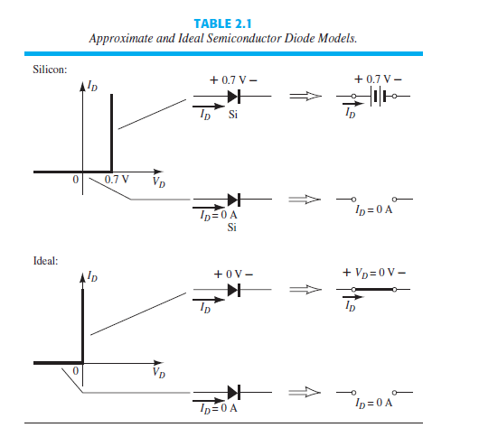
Series diode configuration.

Slide 39
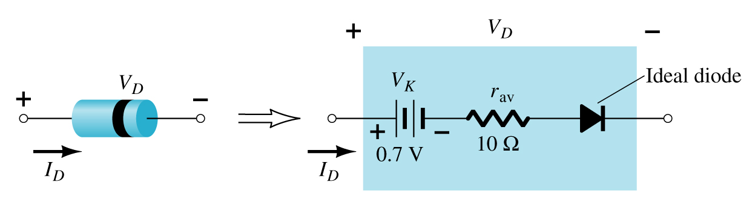
Diode Equivalent Circuit

Slide 40

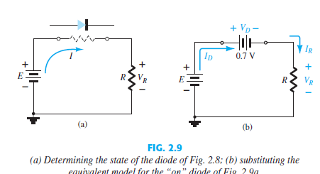
Series diode configuration

Slide 41
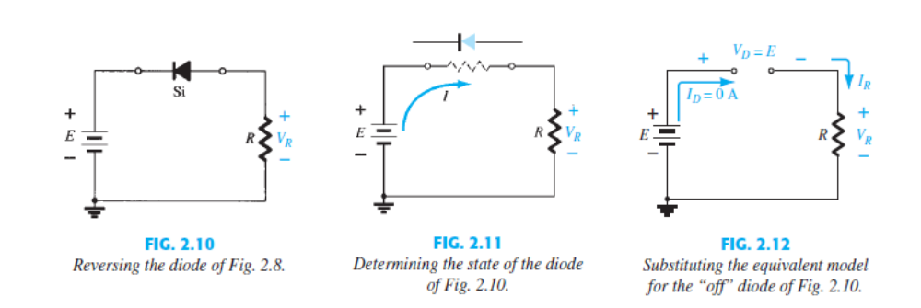
Series diode configuration

Slide 42

Series Diode Configurations
Reverse Bias
Diodes ideally behave as open circuits
Analysis
V_{D} = E
V_{R} = 0 V
I_{D} = 0 A

Slide 43
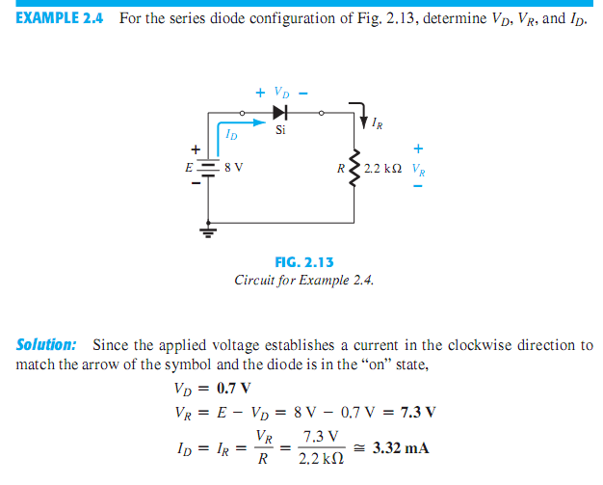
Series Diode Configurations

Slide 44
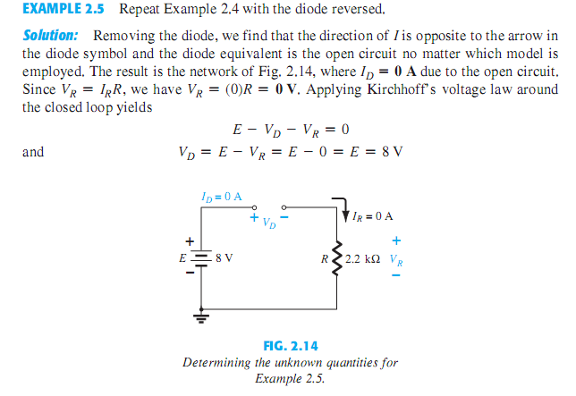
Series Diode Configurations

Slide 45
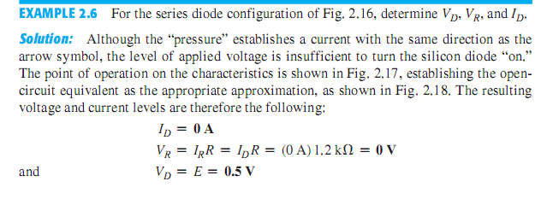
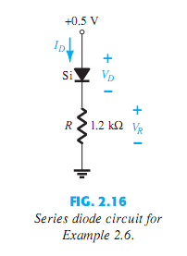
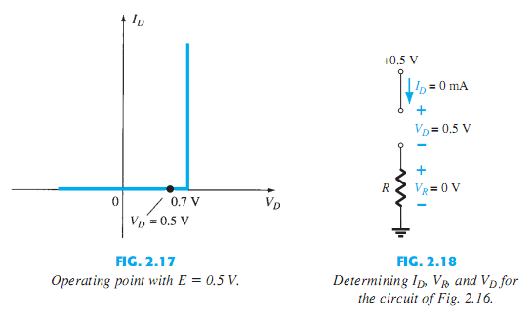
Series Diode Configurations

Slide 46
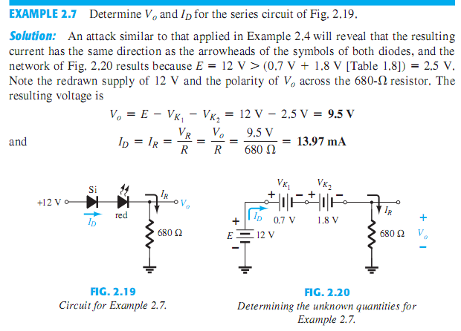
Series Diode Configurations

Slide 47
Diode Characteristics in Parallel Configuration
Current carrying capacity increases.
No conduction in resultant diode in both sides.
Areas of Application
High power applications.
Several diodes connected in parallel can match the desired current rating.

Slide 48
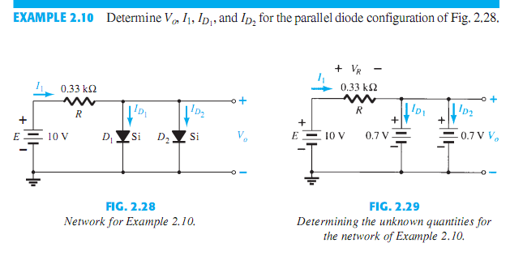
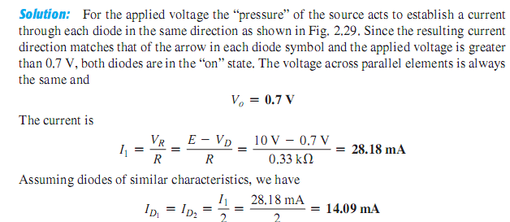
Parallel Configurations

Slide 49
